Slide 1
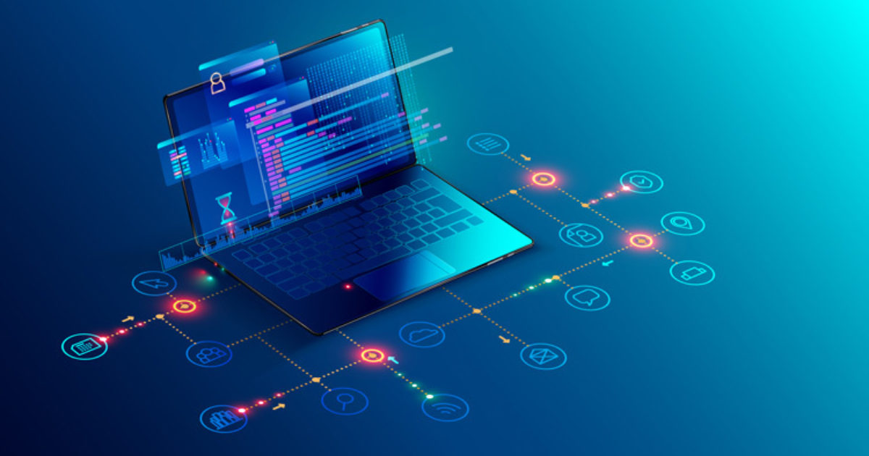
SOFTWARE PRODUCT LINES
PRESENTATION 1
CS515 SOFTWARE MAINTENANCE AND EVOLUTION
NAME: SURAJ ESWARAN
CSUID : 832292077

Slide 2
INTRODUCTION
Reusing the software assert architecture can maximize the investment of time and effort by the company. Developed organizations tend to keep their architectures as an intellectual assert.
Software product line can be considered as a strategy of re using the asset in creating a group of products.
Goal: To reduce cost , improve the delivery time and improve the quality.
“Software Product line is a set of software-intensive systems sharing a common, managed set of features that satisfy the specific needs of a particular market segment or mission and that are developed from a common set of core assets in a prescribed way.”
-Paul Clements

Slide 3
SOFTWARE PRODUCT LINES VS TRADITIONAL SOFTWARE REUSE
TRADITIONAL SOFTWARE REUSE | SOFTWARE PRODUCT LINES
Repository created by the organizations would result in taking longer time to find the desired functionality. | SPL is lot more elaborative where the product line development reuse is planed, enabled and enforced.
Reuse library with components , modules and algorithm. | Reuses the artifacts that are the most costly to develop; domain models, requirements, architecture, components, test cases, and performance models. These are called as core assets.
Does not follow clone and own approach | SPL follows clone and own approach

Slide 4

COMPONENTS NECESSARY FOR A SOFTWARE PRODUCT LINE TO WORK
Requirements
Architectural design
Elements
Modelling and analysis
Testing
Project Planning
Processes, methods and tools
People
Exemplar systems
Defect elimination

Slide 5
SOFTWARE PRODUCT LINE ACTIVITIES
SOFTWARE PRODUCT LINE
CORE ASSET DEVELOPMENT
MANAGEMENT
PRODUCT DEVELOPMENT
FIGURE 1: ACTIVITIES INVOLVING SOFTWARE PRODUCT LINES

Slide 6
CORE ASSET DEVELOPMENT
Goal: To establish a production capability for products.
It happens within a situational context of existing constraints and resources.
4 main contextual factors are:
Product Constraints
Production Constraints
Production Strategy
Pre existing Assets
Three things, which are the outputs of the core asset development activity, are required for a production capability to develop products:
Product Line Scope
Core Asset Base
Production Plan

Slide 7
CORE ASSET DEVELOPMENT
CORE ASSET DEVELOPMENT
MANAGEMENT
PRODUCT CONSTRAINTS
PRODUCTION CONSTRAINTS
PRODUCTION STRATEGY
PREEXISTING ASSETS
PRODUCT LINE SCOPE
CORE ASSETS BASE
PRODUCTION BASE
FIGURE 2: CORE ASSET DEVELOPMENT

Slide 8
PRODUCT DEVELOPMENT
Depends on Product Line Scope, Core Assets and Production Plan and the product description for each individual product.
Inputs:
Product Line Scope: Shows whether indicates it is necessary to include the product under consideration in the product line
Product description for a particular product
Core Assets: from which the product is built
Production Plan: details of how the core assets are to be used to build the product

Slide 9
MANAGEMENT
Plays an important role in successful fielding of a product line.
Management at both technical and organizational levels to be strongly committed to the software product line effort.
Technical management overlooks the core asset development and product development activities.
Organizational management determines a funding model that will ensure the evolution of the core assets and then provides the funds accordingly.

Slide 10
GROWTH METHODS OF PRODUCT LINES
Many organizations begin these by developing the core assets first. They use a proactive approach where they define their product line scope to define the set of systems that will constitute their product line.
Another approach is called reactive approach where the organizations begin with one or a small number of products they already have and then use them to generate the product line core assets and future products.

Slide 11
PROACTIVE VS REACTIVE APPROACH
Proactive Approach | Reactive Approach
Begin with the most important core assets | Begins with all the core assets, irrespective of its importance.
High cost of entry to software product lines | Much lower cost of entry to software product lines
Products come to market extremely quickly with a minimum of code writing. | Even with a maximum code writing, it takes time to enter the market.
TABLE 1: DIFFERENCES BETWEEN PROACTIVE AND REACTIVE APPROACH

Slide 12
EVOLUTING A PRODUCT LINE
External Source | Internal Source
New element from produce/ manufacturer to be included in the product line and new product will be produce from it. | For product function in the scope of product line will be using the existing function. If not, new function will be developed, and it needs to be analyzed as whether it needs to be added in the product line or not.
Organization will add new member in product line based on the products that has been developed.
Problem in managing product line evolution that always increasing.
Product evolution arises from 2 sources:
TABLE 2: DIFFERENCES BETWEEN EXTERNAL SOURCE AND INTERNAL SOURCE

Slide 13
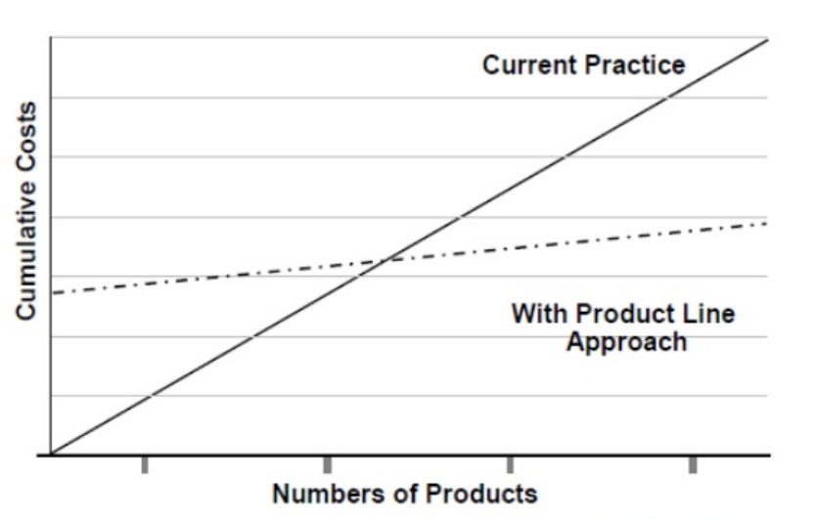
ECONOMICS OF SOFTWARE PRODUCT LINES
FIGURE 3: SOFTWARE PRODUCT LINE APPROACH OVER NUMBER OF PRODUCTS

Slide 14
BENEFITS
Increased Product diversity
Reduction of per product development cost
Reduction in time-to-market
Increase in product quality

Slide 15
PRODUCT LINE EVOLUTION GUIDELINES
Avoid adjusting component interfaces
Mainly focus on bringing component interfaces
Separate domain and application behaviour
Always keep the software product lines complete and undamaged
Detect and exploit common functionality in component implementations
Be open to rewrite components and implementations
Avoid hidden assumptions and design decisions in the source code.

Slide 16
REFERENCES
Clements, P., & Northrop, L. (2002). Software product lines: practices and patterns, vol. 59. Reading: Addison-Wesley. IEEE.
Weiss, D. M., & Lai, C. T. R. (1999). Software product-line engineering: a family-based software development process (Vol. 12). Reading: Addison-Wesley.
Van der Linden, F. J., Schmid, K., & Rommes, E. (2007). Software product lines in action: the best industrial practice in product line engineering. Springer Science & Business Media.
Bosch, J., & Lee, J. (Eds.). (2010). Software Product Lines: Going Beyond: 14th International Conference, SPLC 2010, Jeju Island, South Korea, September 13-17, 2010. Proceedings (Vol. 6287). Springer.
McGregor, J. D. (2003). The evolution of product line assets (No. CMU/SEI-2003-TR-005). CARNEGIE-MELLON UNIV PITTSBURGH PA SOFTWARE ENGINEERING INST.
Schach, S. R., & Tomer, A. (2000). Development/maintenance/reuse: software evolution in product lines. In Software Product Lines (pp. 437-450). Springer, Boston, MA.

Slide 17


QUESTIONS???

